Slide 1
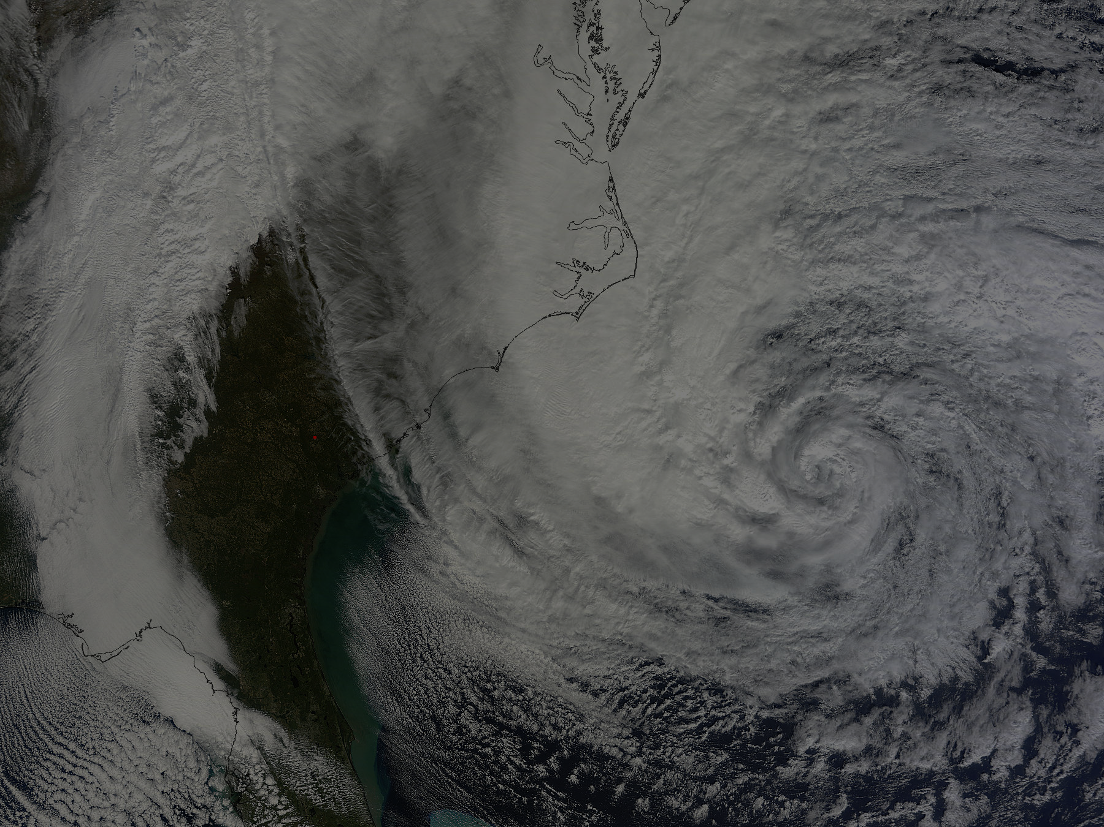
Recent COAMPS-TC Development and Real-Time Tests
Outline
Current Status
Improvements for 2013
Initial Condition Sensitivity
Summary and Future Plans
James D. Doyle, R. Hodur¹, J. Moskaitis, S. Chen, E. Hendricks, T. Holt, H. Jin, Y. Jin, M. Peng, A. Reinecke, K. Sashegyi, J. Schmidt, S. Wang
Naval Research Laboratory, Monterey, CA
¹SAIC, Monterey, CA
Sponsors: ONR, PMW-120, NOAA HFIP, NOPP
Hurricane Sandy 28 October 16Z (NASA MODIS)

Slide 2
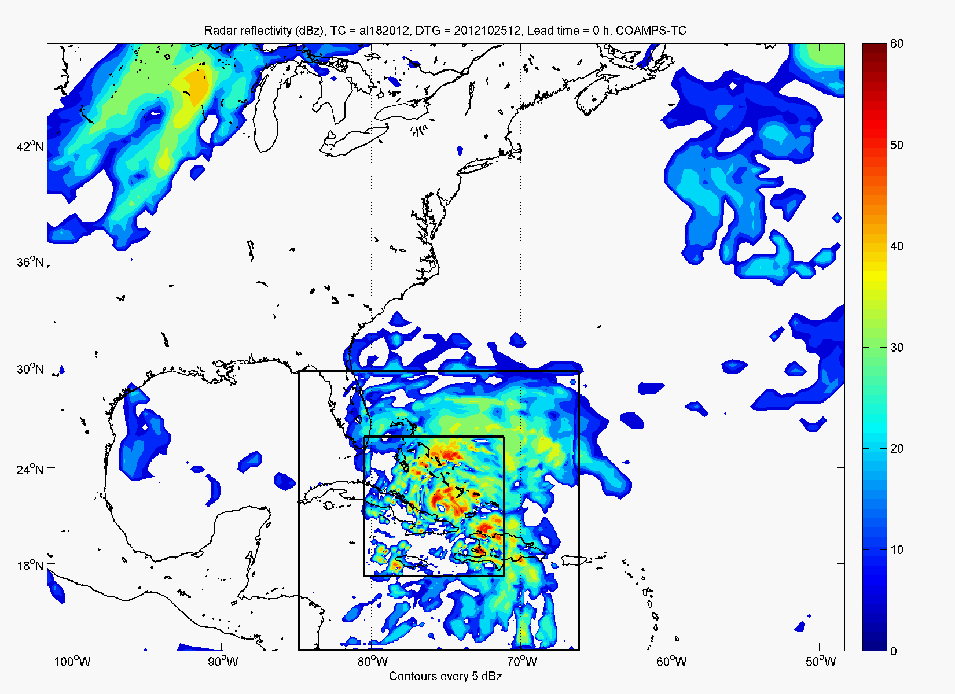
COAMPS-TC System Overview
Analysis: 3D-Var (NAVDAS), synthetic observations
Atmosphere: Nonhydrostatic, moving nests, TC physics
Ocean: 3D-Var (NCODA), ocean (NCOM), wave (SWAN, Wave Watch III)
Ensemble: COAMPS-TC EnKF DART, Coupled Ensemble Transform
Real-Time Navy pre-ops. tests & NOAA HFIP partnership activities Testing: 45-15-5 km, GFS/NOGAPS BCs, cycling DA, uncoupled/coupled
Sandy (2012) Simulated Radar Reflectivity

Slide 3
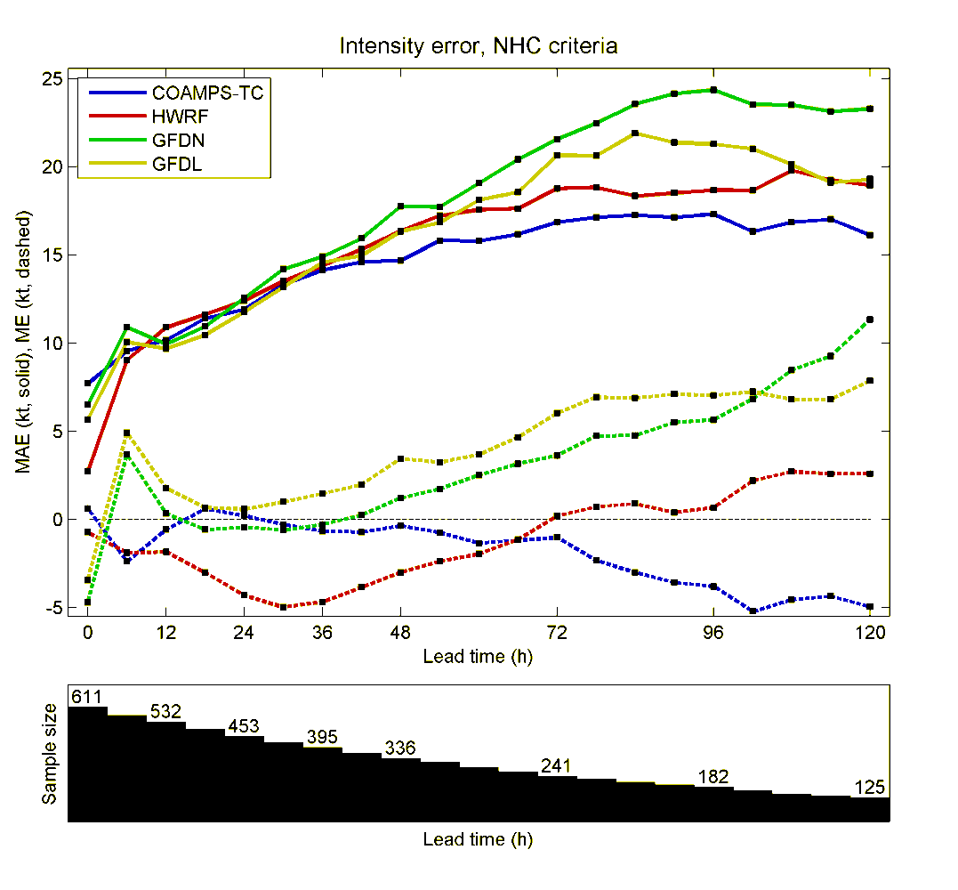
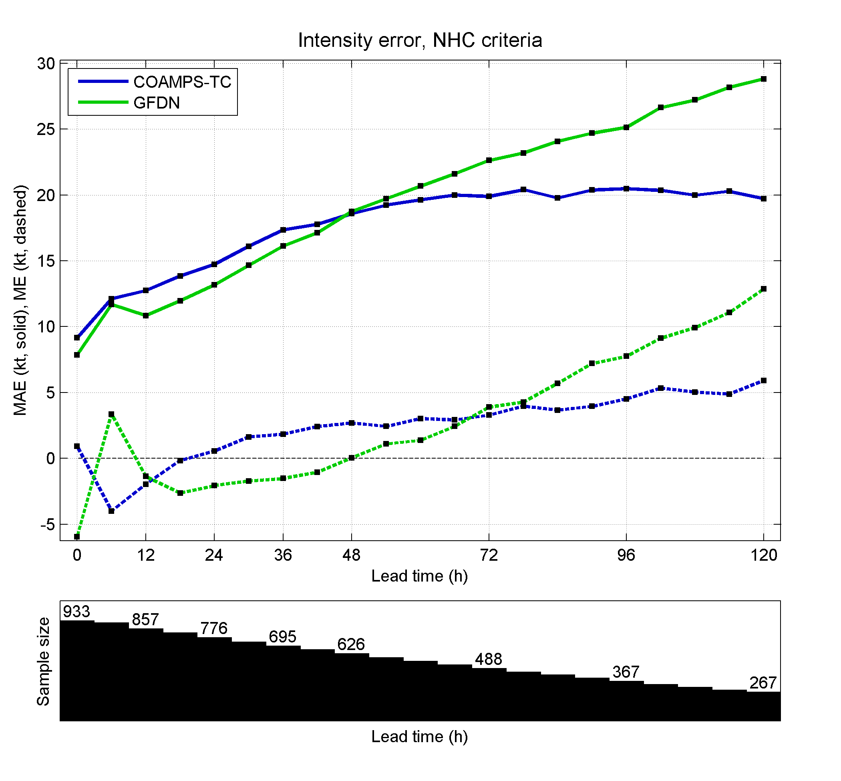
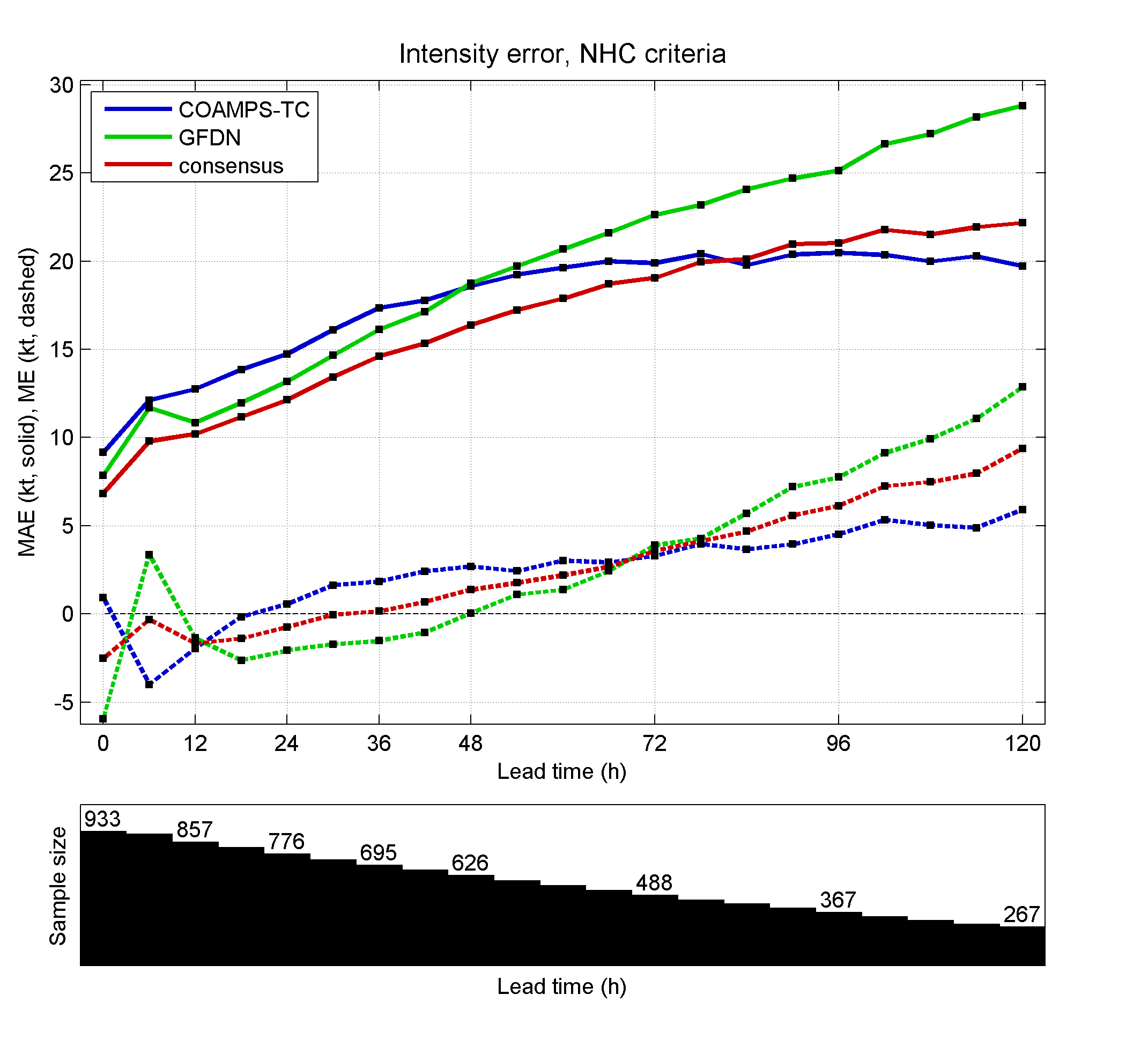
COAMPS-TC Transition to Navy Ops
Validation Test Report approved by Validation Test Panel in March 2012.
Operational Testing currently underway at FNMOC.
COAMPS-TC full operational implementation expected Spring 2013.
COAMPS-TC Air-Sea Coupled Model, transition target – 1QFY14.
W. ATL Intensity (Wind) Error (Kts)
2010-2011
W. PAC Intensity (Wind) Error (Kts)
2009-2011
GFDN
GFDN
COAMPS-TC
COAMPS-TC
Consensus
bias is dashed
Sample Size
Sample Size

Slide 4
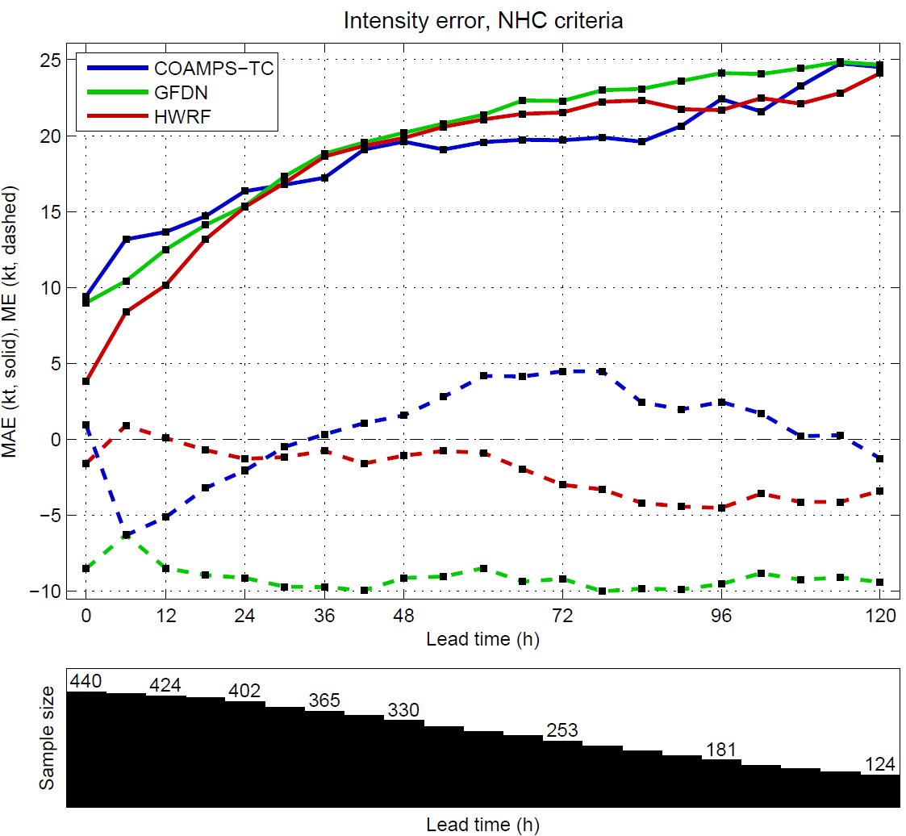
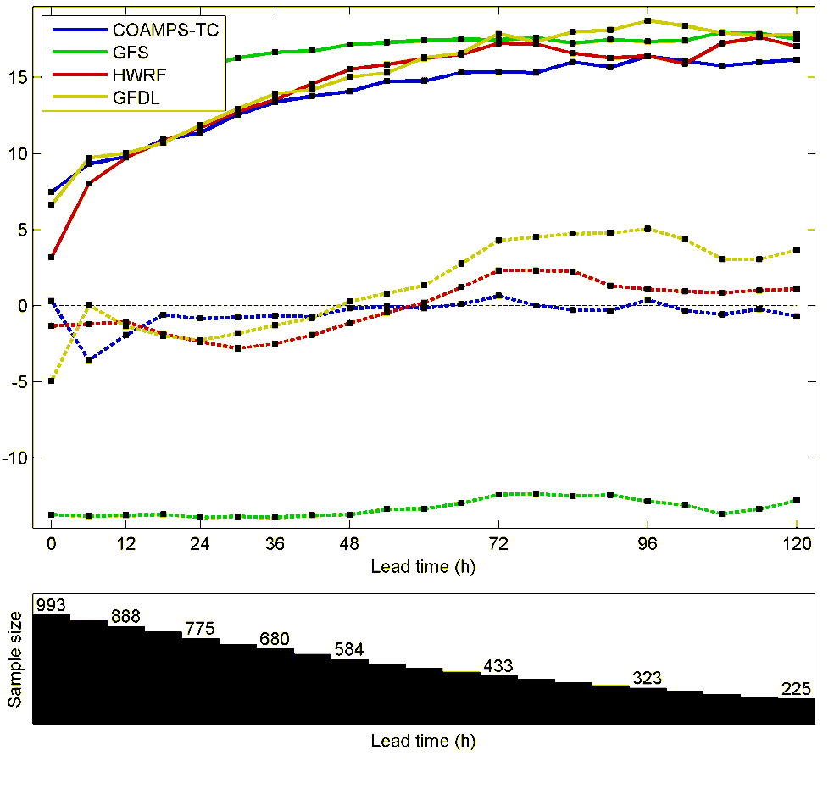
W. Pacific and W. Atlantic Intensity Error Real-Time Forecasts
W. Pacific Intensity Error (kt)
2012
W. Atlantic Intensity Error (kt)
2010-2012
COAMPS-TC
COAMPS-TC
bias is dashed
bias is dashed
COAMPS-TC real-time intensity forecasts in W. Pacific (2012) and W. Atlantic (2010-2012) verified well, particularly beyond 36 h.

Slide 5
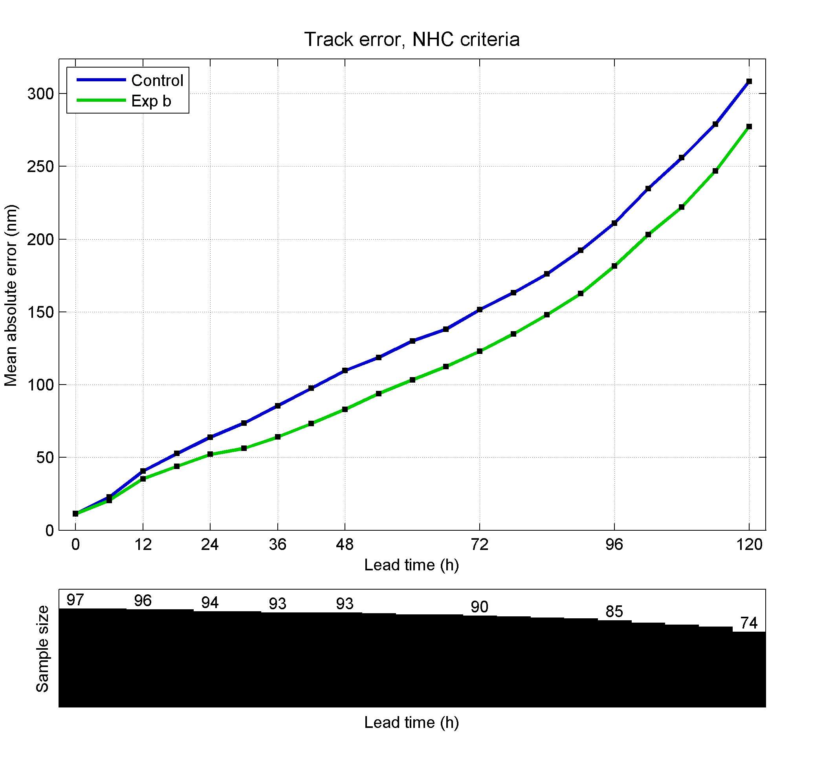
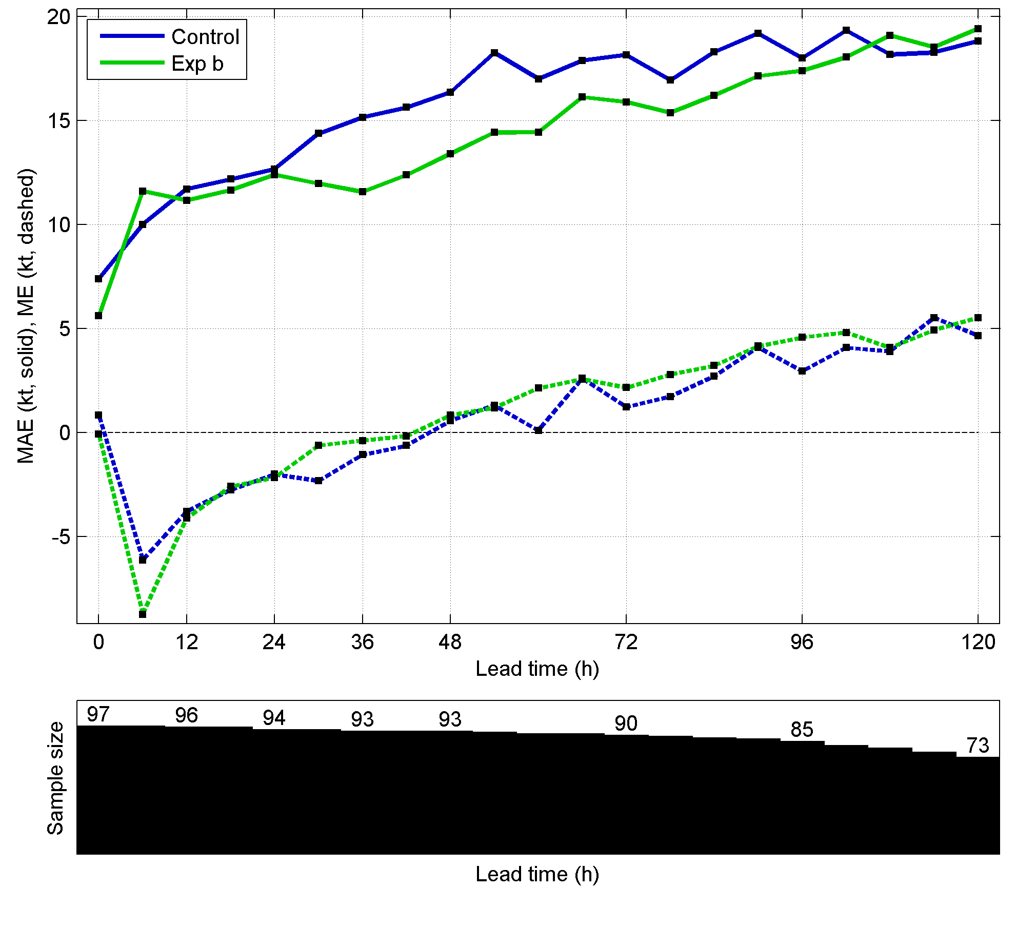
COAMPS-TC Development
Synthetic Observations for Data Assimilation
Track Error (nm)
Intensity Error (kts)
Control
New
Synthetics
Control
New
Synthetics
Bias (dash)
1000-mb Winds
Synthetic Observations
New synthetic observation algorithm has been developed.
Based on the TC-vitals (JTWC, NHC) and a Rankine vortex distribution
61 profiles are assimilated with 3D-Var (NAVDAS) using cycling DA on all meshes.
New synthetics significantly improve the track (~20%) and intensity (10-20%) errors.

Slide 6
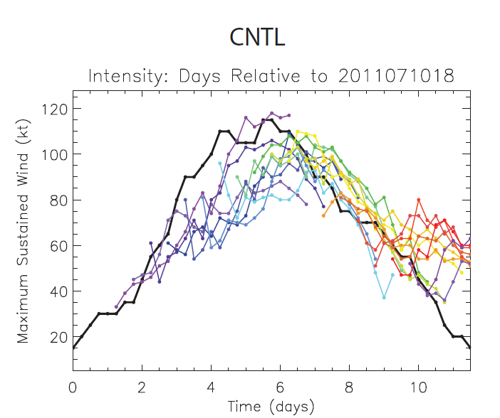
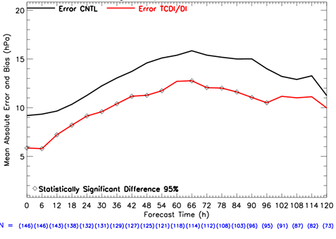
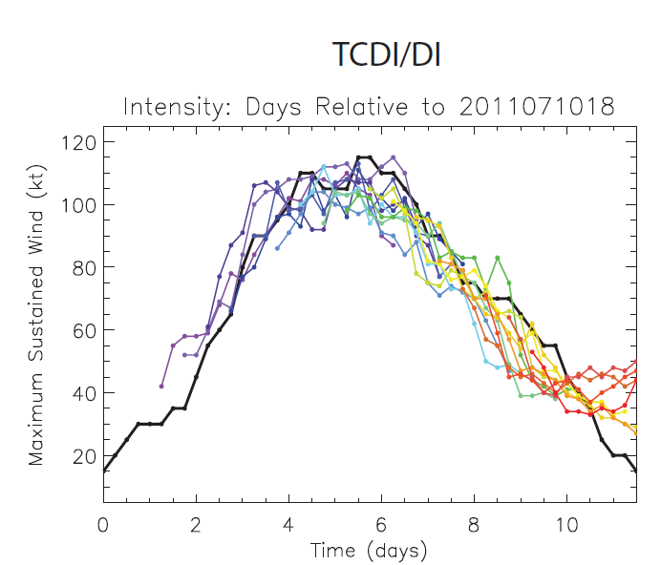
COAMPS-TC Development
Dynamical Initialization
Typhoon Ma-On (2011)
Intensity (kts)
Large Sample Intensity Error (kts)
Best
Control
Control
Dynamical
Initialization
DI
Best
146
129
95
73
New dynamical initialization algorithm has been developed.
Uses a balanced vortex that is spun-up outside COAMPS-TC
Newtonian relaxation over first 12-h to allow the secondary circulation to develop.
Dynamical initialization improves the track & especially intensity (>20%) forecasts.

Slide 7
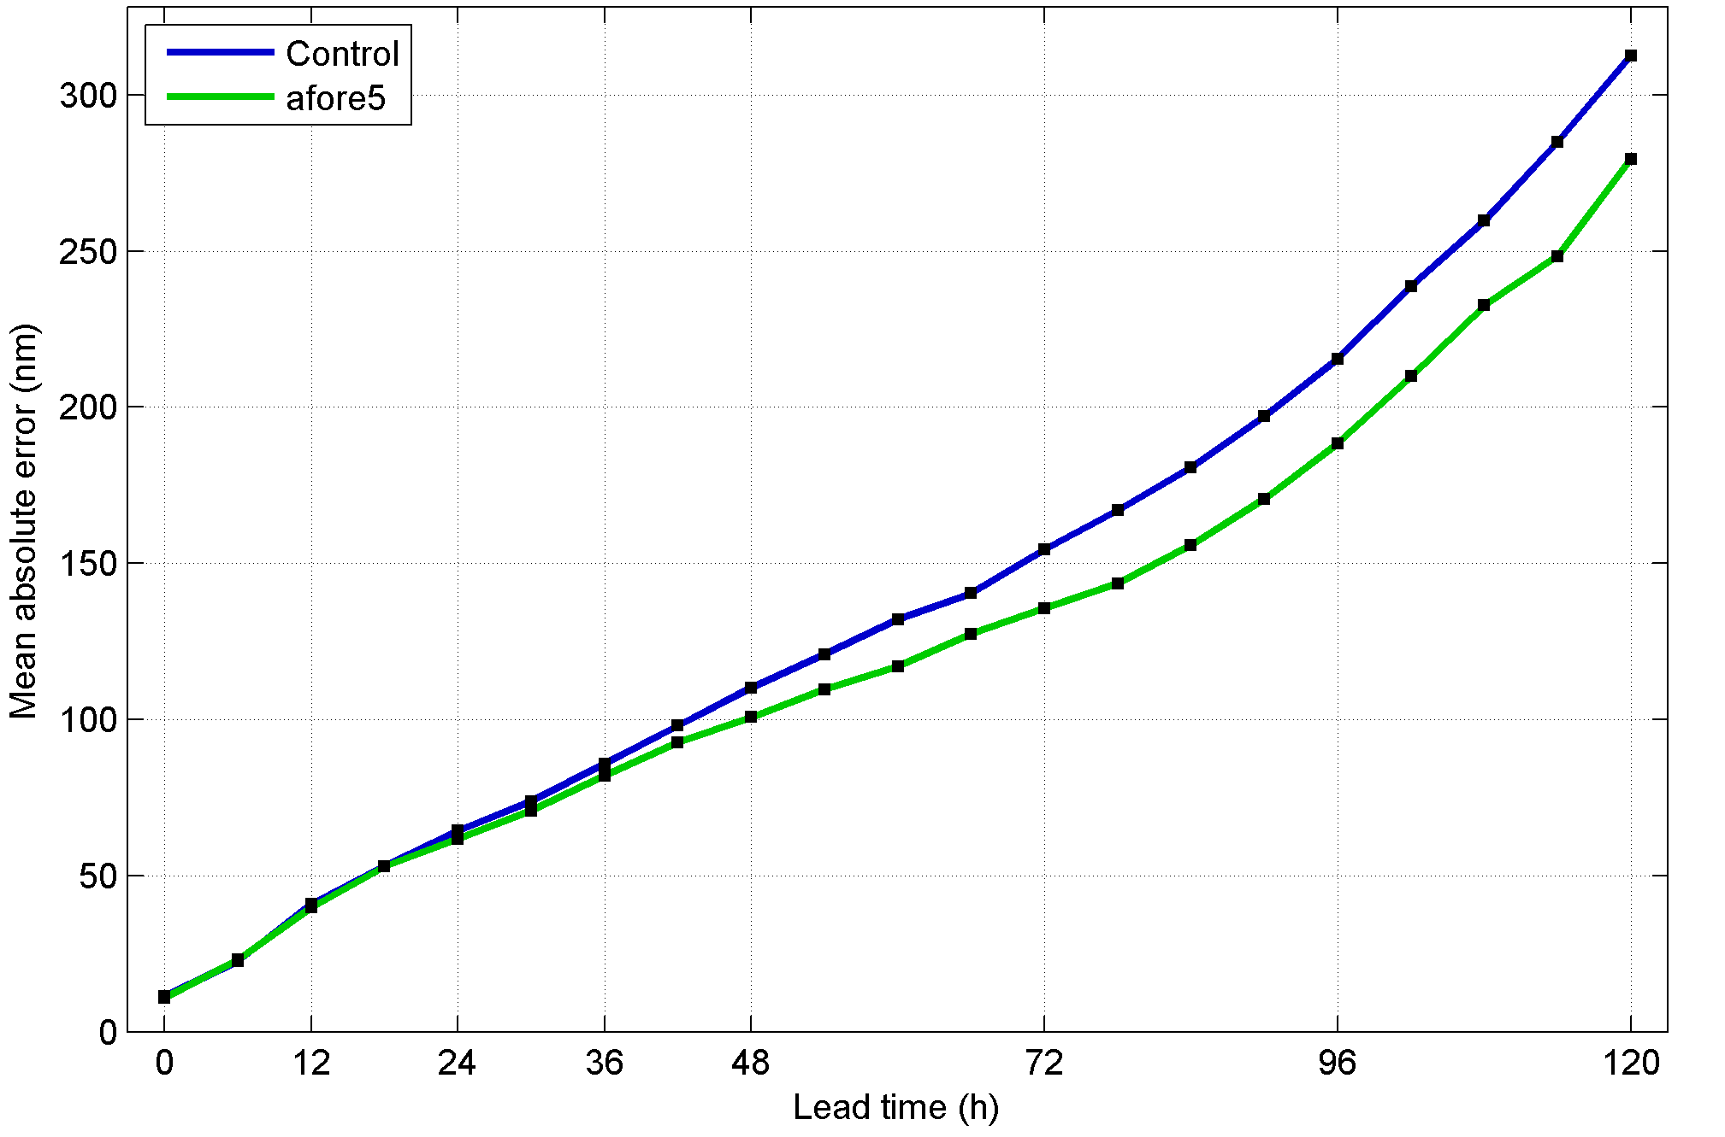
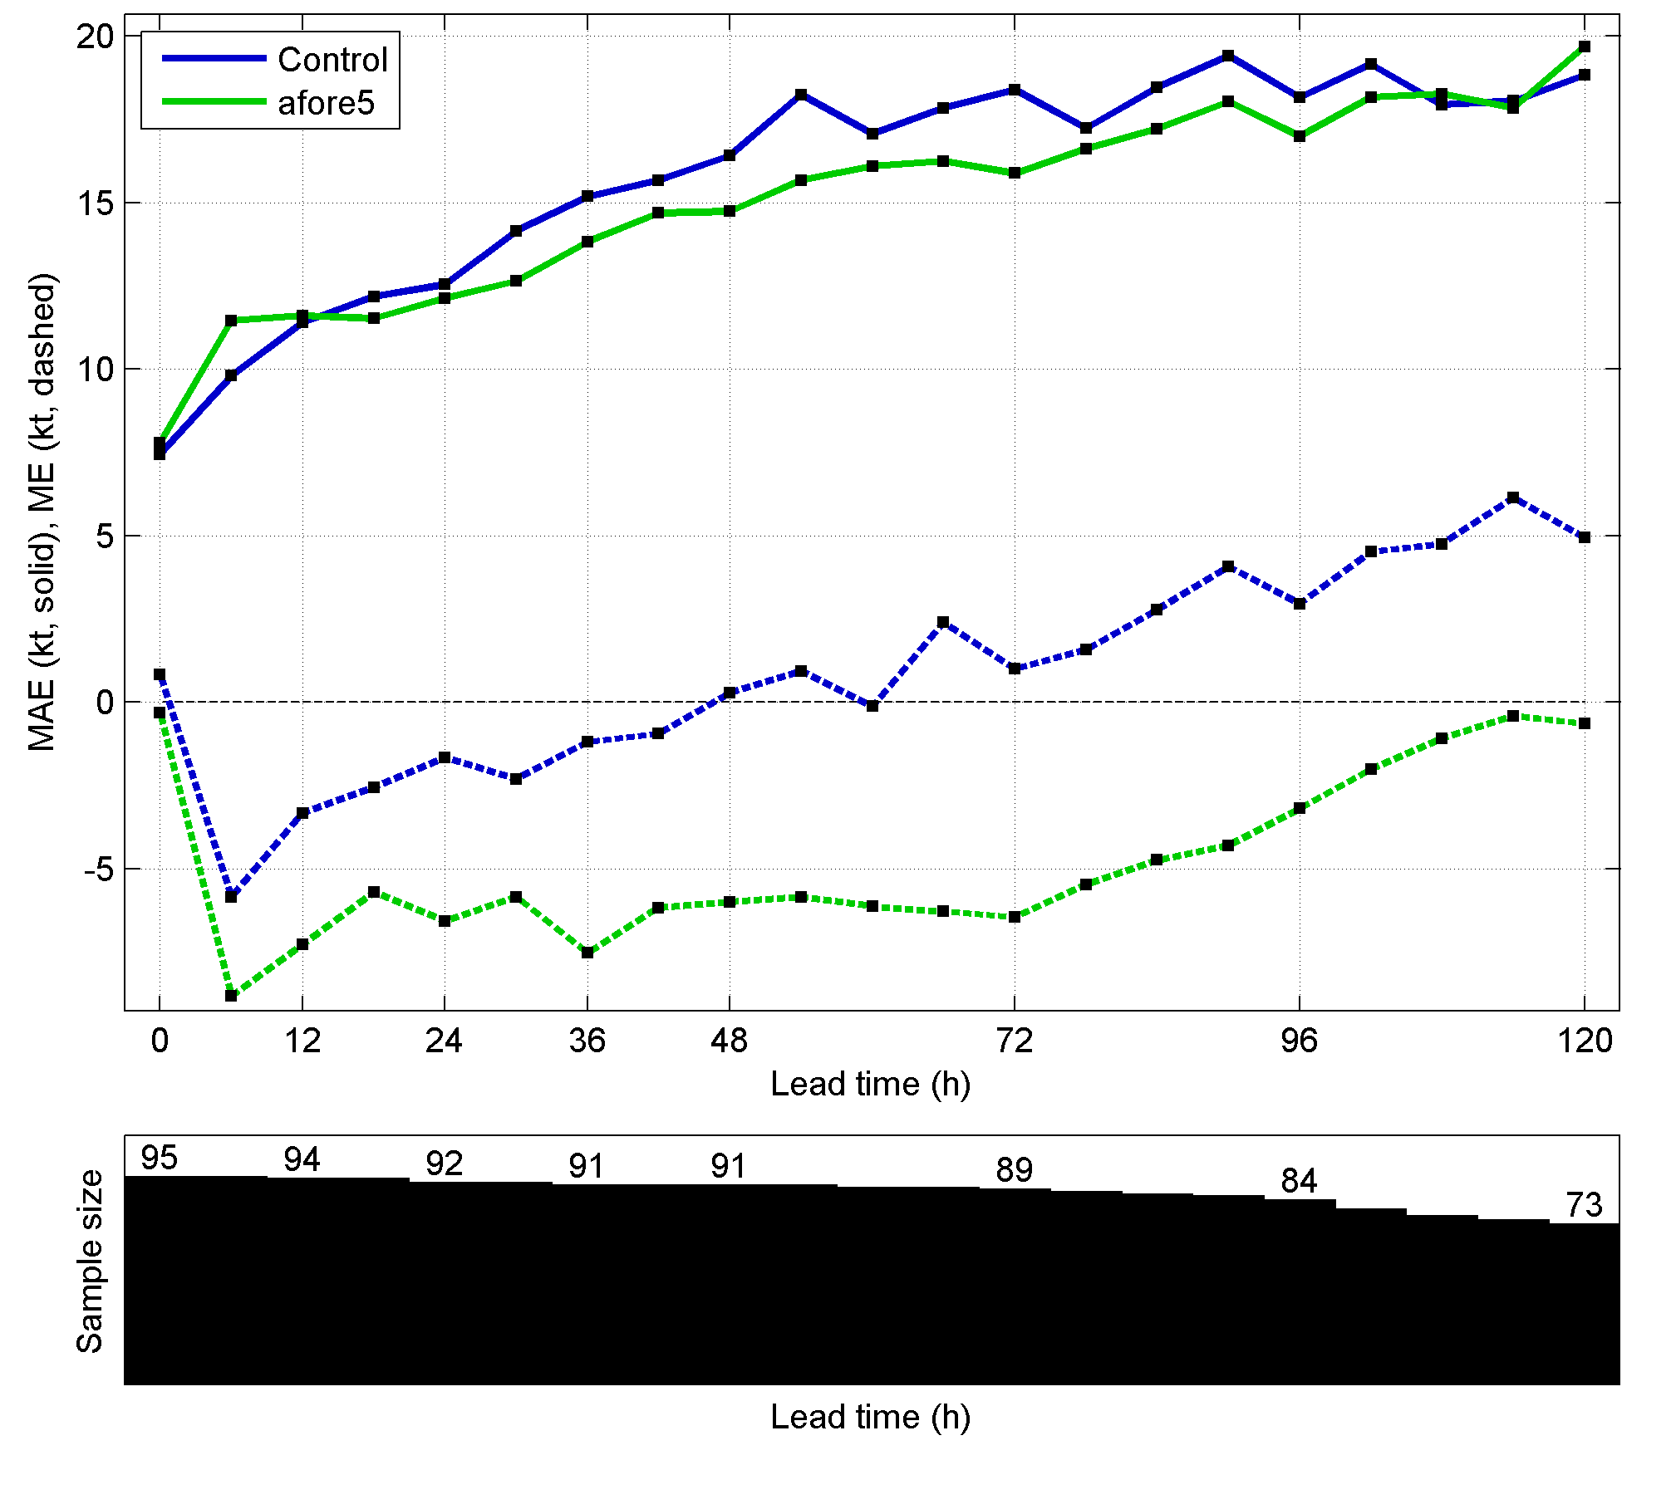
COAMPS-TC Development
Hurricane Boundary Layer Parameterization
Bougeault PBL
Nonlocal formulation dependent on turbulence kinetic energy (TKE) and thermal stability.
New approach for BL mixing length near the surface
Track Error (nm)
Control
New PBL
New PBL Significantly Improves Both Track and Intensity
θ_{v}
Control
New PBL
Intensity
Error (kt)
Bias (dash)
surface

Slide 8
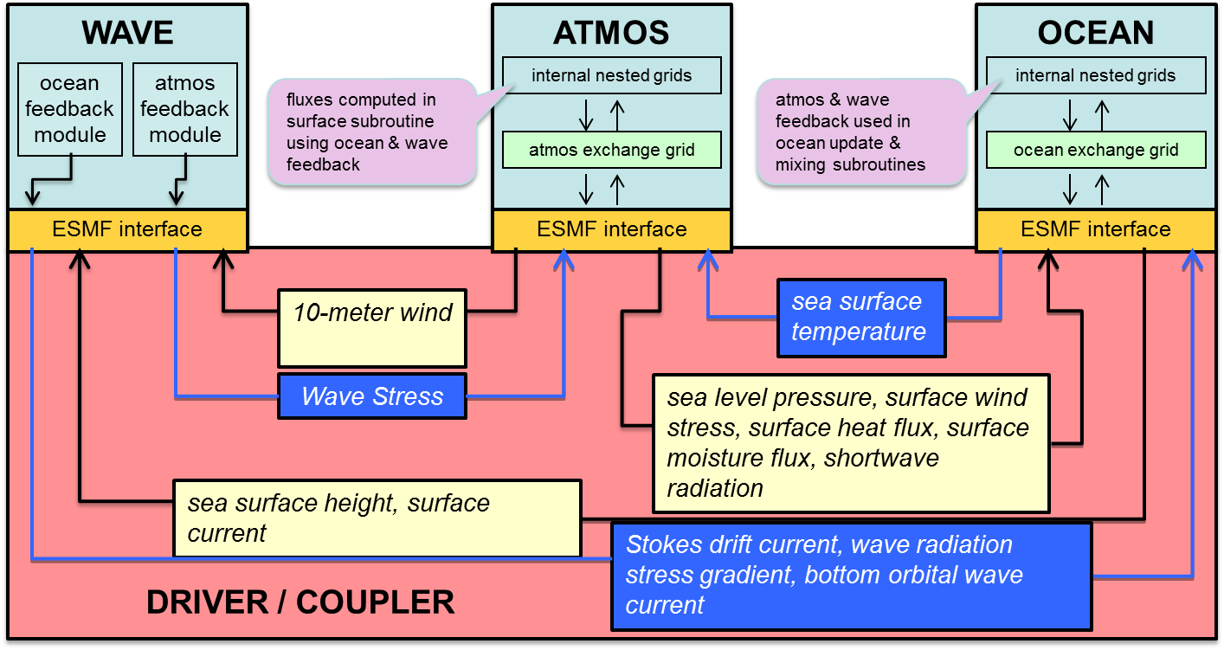
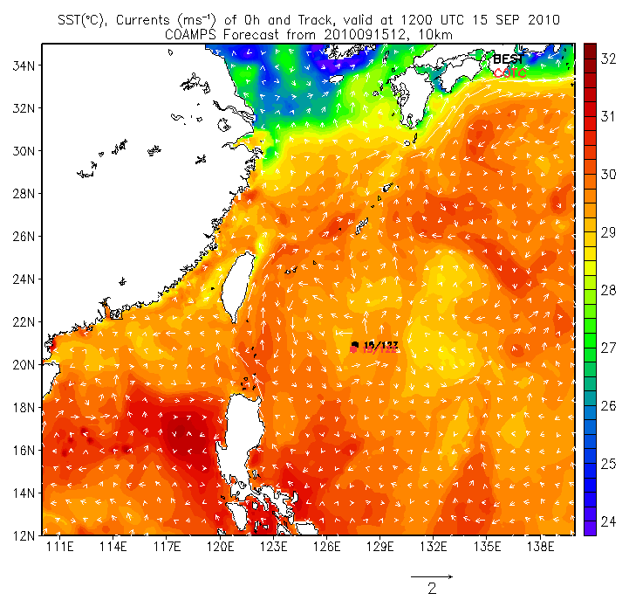
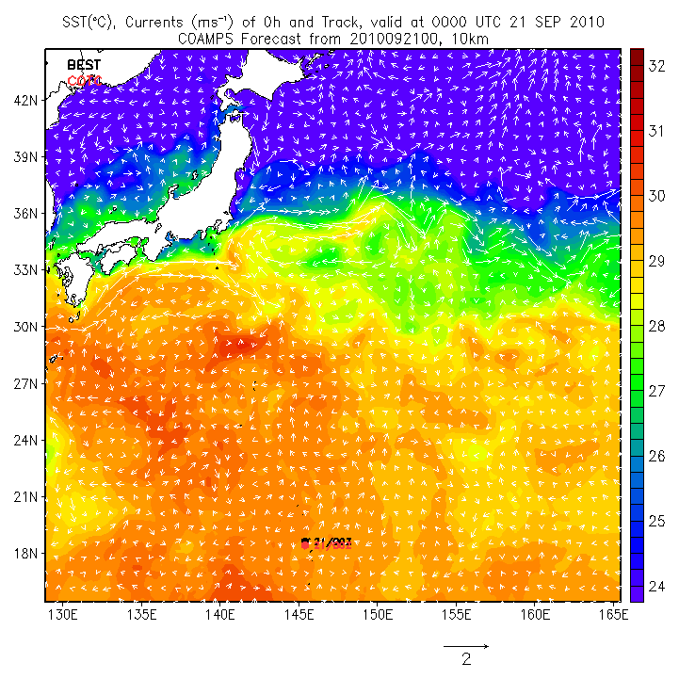
COAMPS-TC Development
Coupled Air-Sea Interface Physics Earth System Modeling Framework (ESMF)
ONR ITOP TY Fanapi: SST (°C), Currents
ONR ITOP TY Malakas: SST, Currents
Best Track
COAMPS
Best
COTC
00Z 21 Sep 2010
12Z 15 Sep 2010
Coupled Real–Time COAMPS-TC Predicts SST Wake of 2-4°C in Agreement with Observations
COAMPS contains a community based (ESMF) coupler to facilitate flexible and generalized exchange between components.
Air-Sea (COAMPS-NCOM) coupling transition to ops in FY14.
Air-Sea-Wave (COAMPS-NCOM-WWIII) coupling transition in FY15.

Slide 9
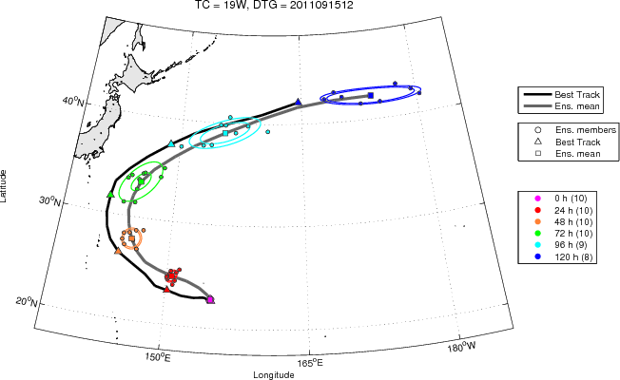
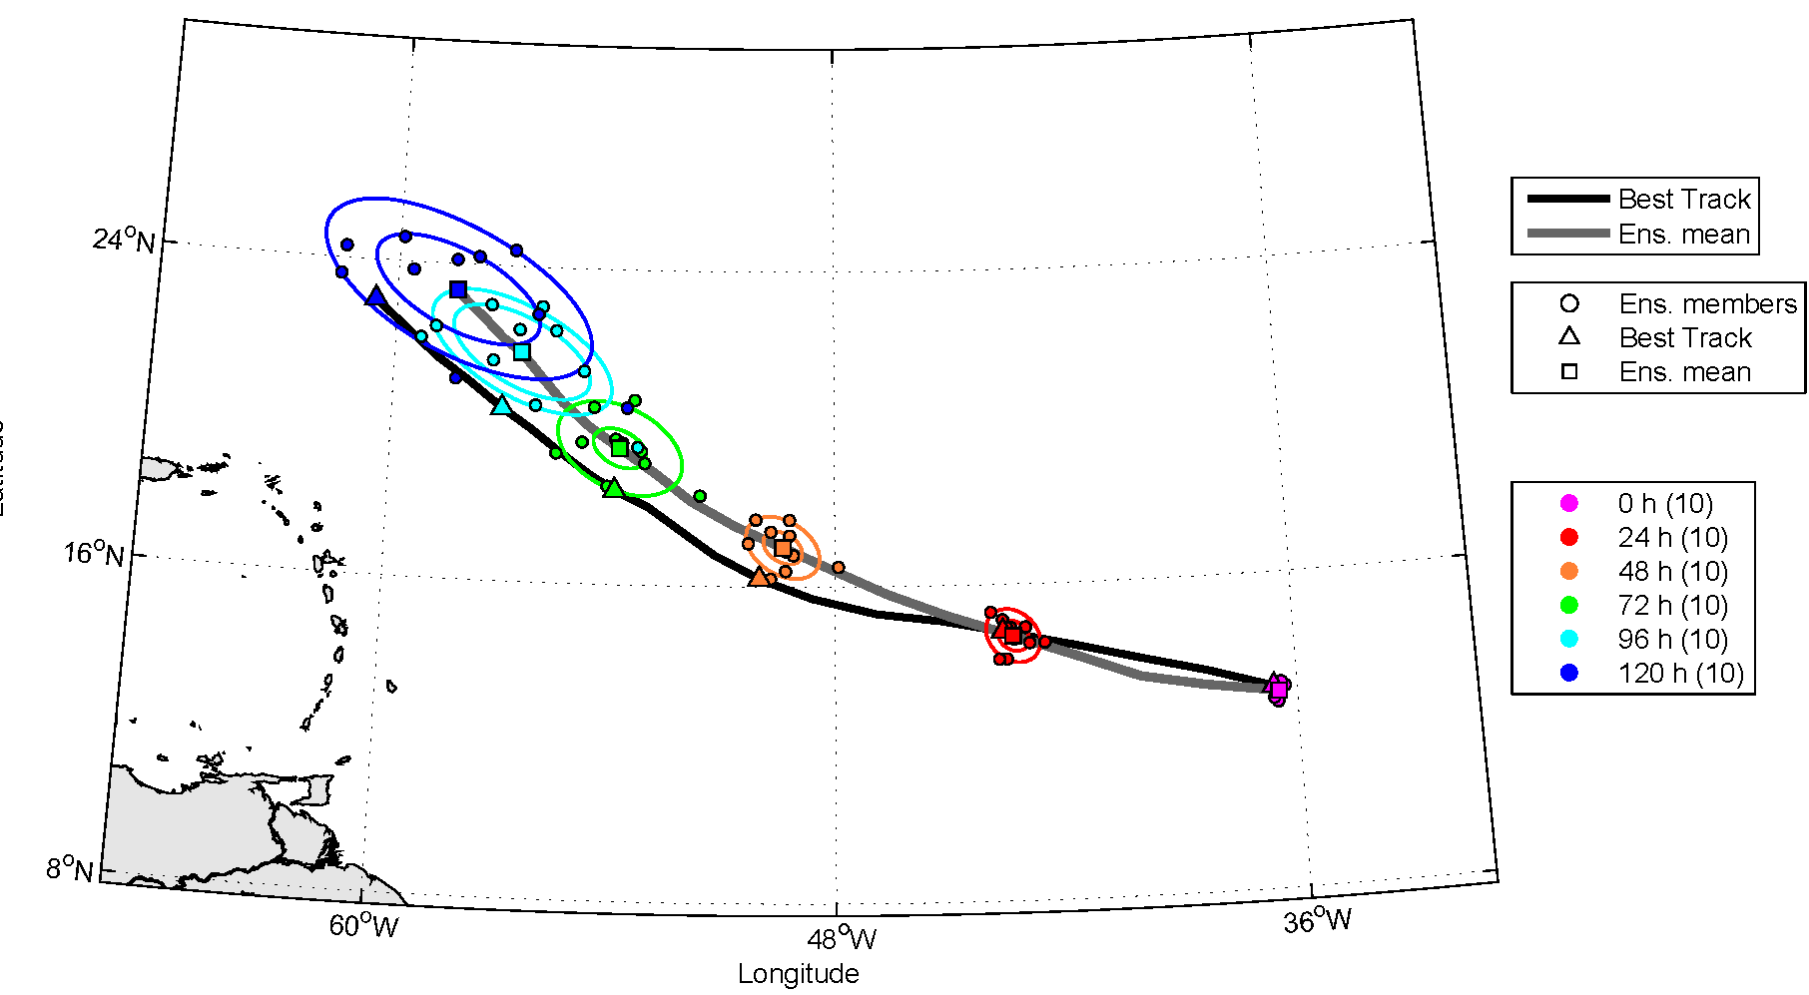
COAMPS-TC Developments
Ensemble Kalman Filter
Sonca 2011 (WestPac) 12 UTC 15 September
Katia 2011 (Atlantic) 00 UTC 31 August
COAMPS-TC EnKF system has been developed based on the community-based DART effort (NCAR/NSF).
COAMPS-TC EnKF run in real time in 2011-2012 for WATL & WPAC.
Real-time probabilistic guidance for track and intensity in 2013.

Slide 10
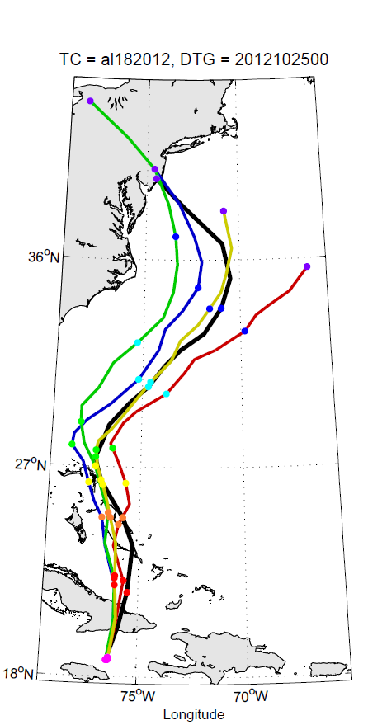
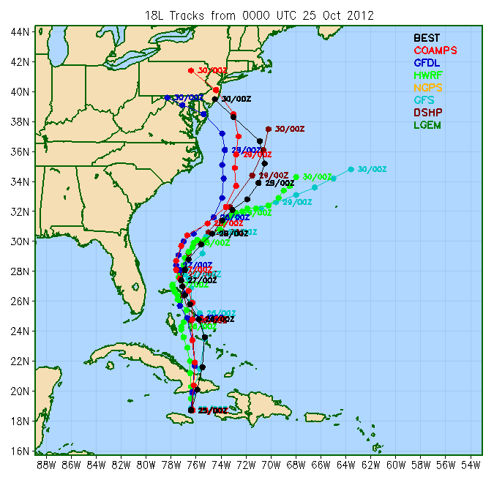
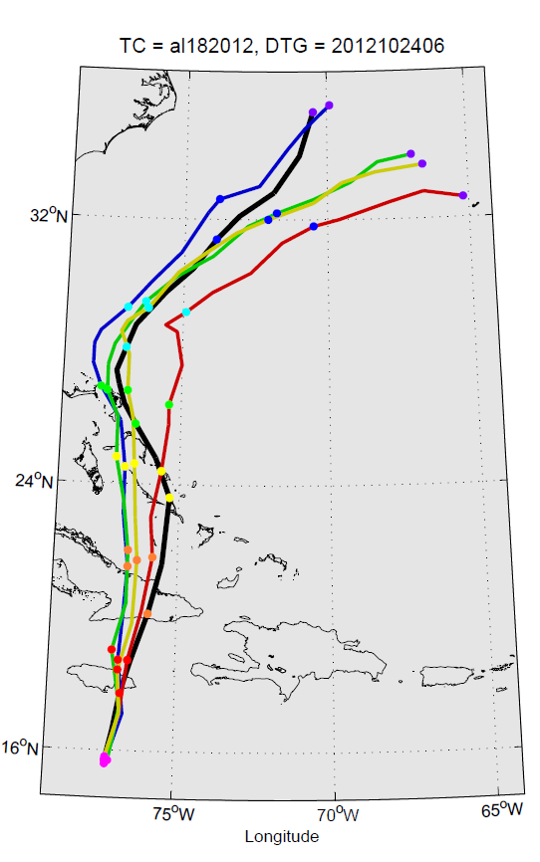
Initial Condition Sensitivity: Sandy
Data Denial Experiments
Ops/Real-Time Tracks for Sandy (00Z 25 Oct)
06Z 24 Oct.
00Z 25 Oct.
Track Error (nm)
No Sat.
Winds
Control
No Sat.
Winds
Control
Best Track
Some operational models erroneously recurved Sandy out to sea (prior to 18Z/25 Oct).
COAMPS-TC assimilated satellite-derived atmospheric motion vectors (mostly in mid- and upper levels) have a large impact on the track for Sandy.
Impact of the 06Z and 18Z radiosondes and satellite TPW are secondary (still important).

Slide 11
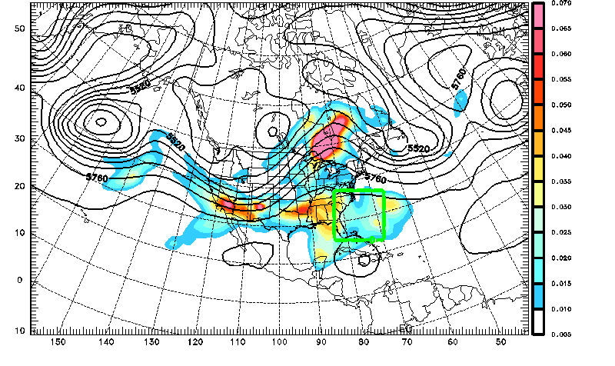
COAMPS-TC Initial Condition Sensitivity
Large-Scale Adjoint Sensitivity
Total Energy Sensitivity and 500-mb Heights
Initialized at 00Z 25 October (96-h Sensitivity)
L
Rossby
Wave
Dispersion
Sandy
at Final
Time
Δx= 90 km
COAMPS-TC adjoint sensitivity (4 day) highlights the importance of:
Ridge to the north
Upstream trough and the mid-Pacific trough (Rossby wave dispersion)
Local regions just to the west and east of the storm

Slide 12
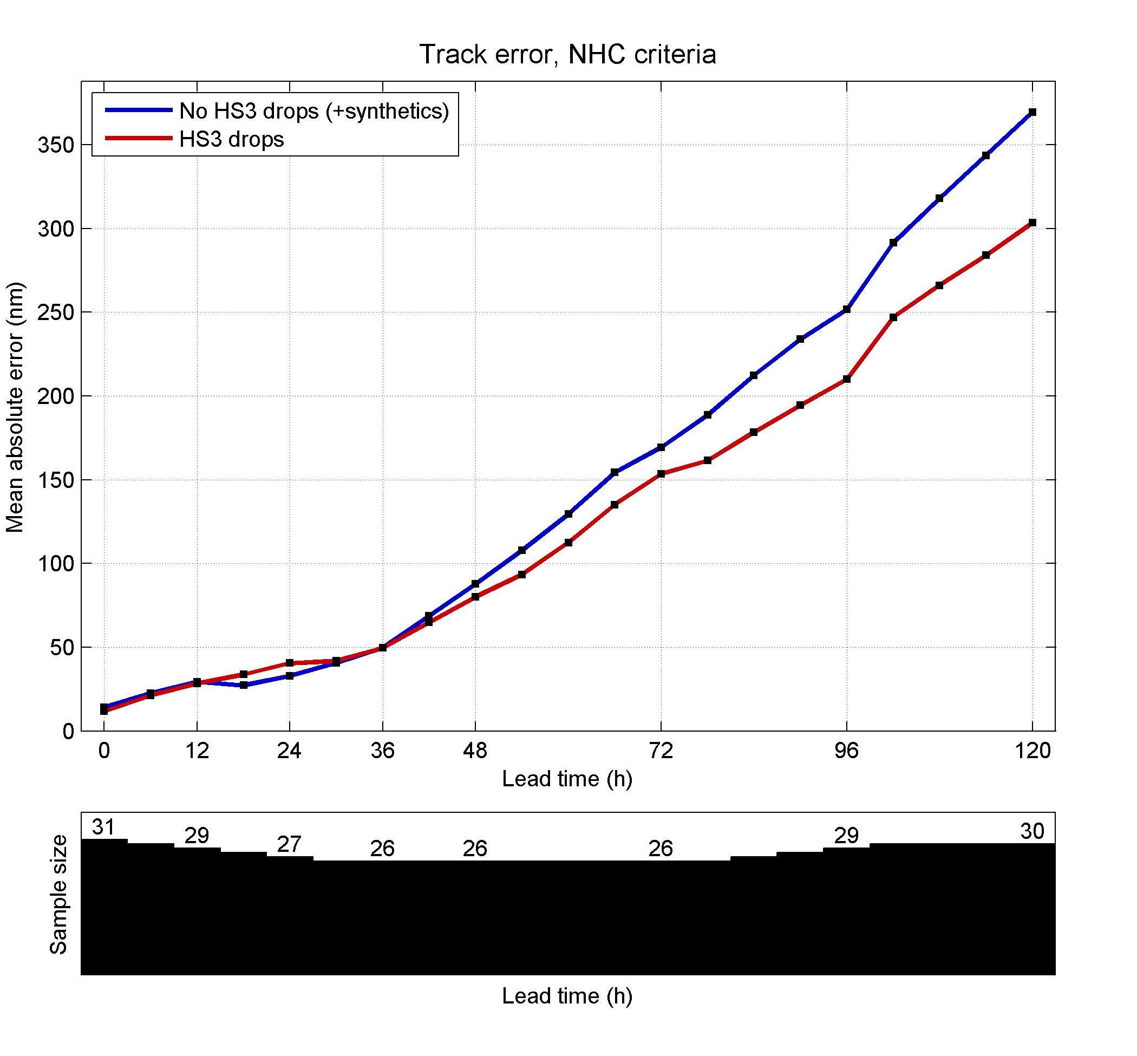
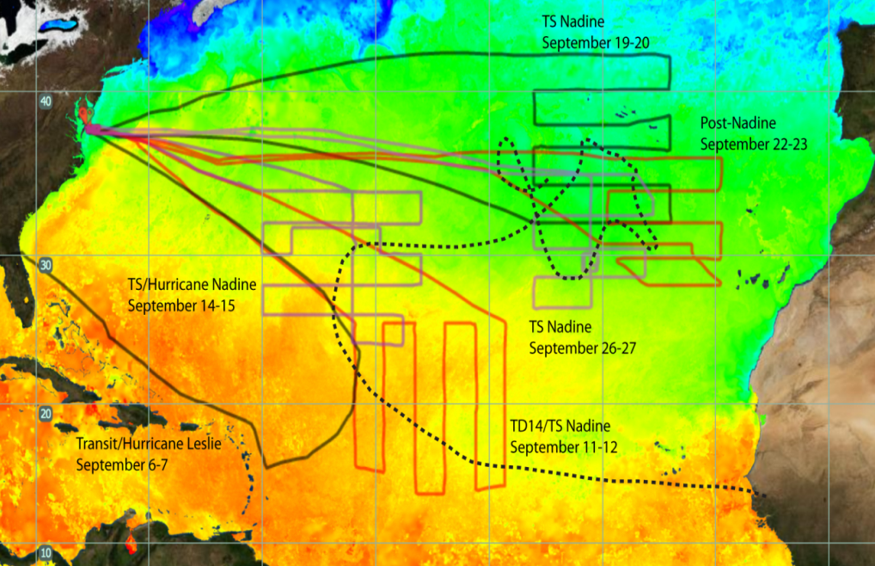
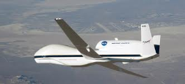
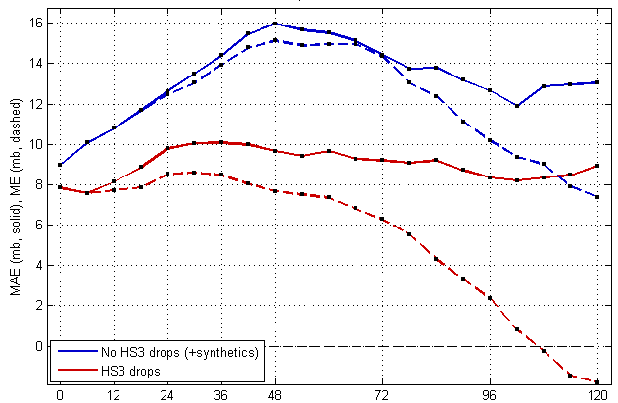
NASA Hurricane Severe Storm Sentinel (HS3) Impact of HS3 Dropsondes for Nadine
Track Error (nm)
HS3 Global Hawk Flight Tracks: Nadine
Intensity: Max. Wind Error (kts)
76 Drops
No drops
No drops
58 Drops
HS3 drops
HS3 drops
70 Drops
75 Drops
Bias (dash)
30 Drops
34 Drops
Intensity: Min. SLP Error (hPa)
No drops
Sensitive regions in Nadine were often well observed by HS3 dropsondes
Dropsonde impact experiments performed for 19-28 Sep. (3 flights)
HS3 drops
No drops with synthetics
COAMPS-TC intensity and track skill are markedly improved using HS3 drops.
HS3 drops
Bias (dash)

Slide 13
COAMPS-TC Summary and Future Plans
Promising Intensity Skill:
COAMPS-TC intensity forecasts verified well in 2010-12 in WATL & WPAC
10-20% improvement in intensity and track in 2013 version
Assimilation of dropsondes from the HS3 Global Hawks is very promising
Potential for TC targeted observations for intensity
Future Plans:
COAMPS-TC in Ops Test (current), fully operational in spring 2013
Development of advanced COAMPS-TC (underway)
- Resolution: 5 km (current) to 3 km to 1 km; 40L to 60L to 80L
- TC physics: PBL, air-sea fluxes, microphysics
Data assimilation: EnKF, 4D-Var, radiances, radar, HDOB, SFMR
- Coupling: Ocean (NCOM), waves (WWIII/Swan), coupled DA
Leverage field observations (including HS3, ONR Outflow DRI etc.)
Multi-model high-res. ensemble (Navy/NOAA HFIP) prospects are promising.

Slide 14
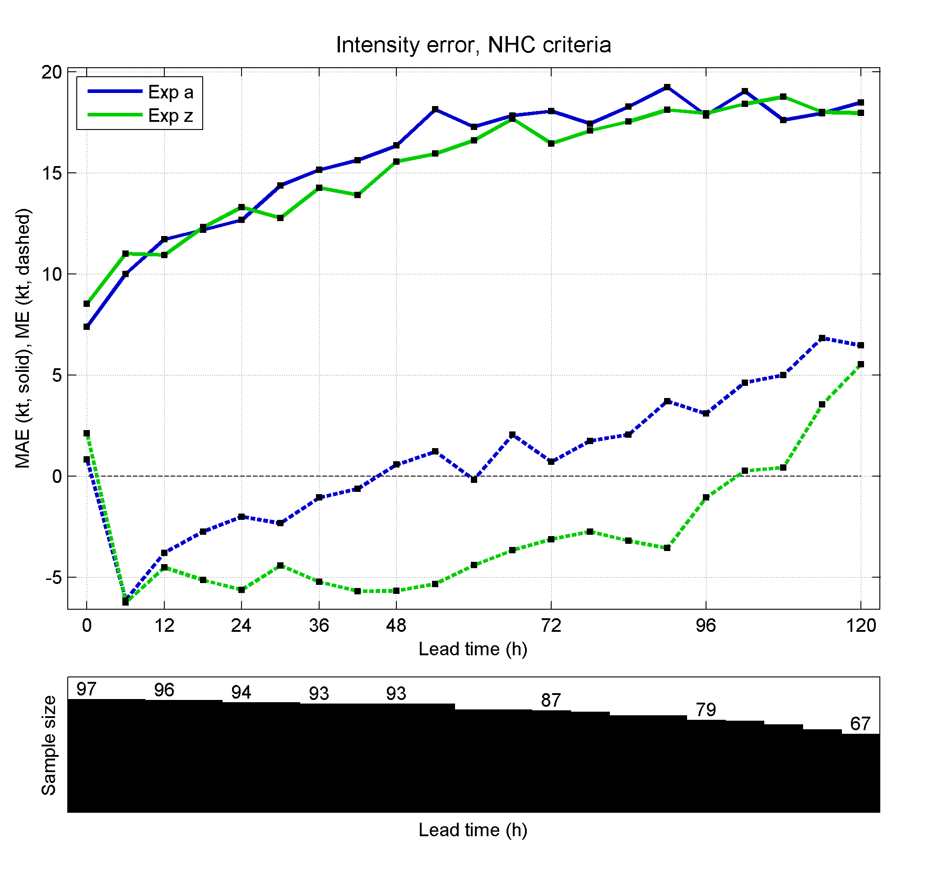
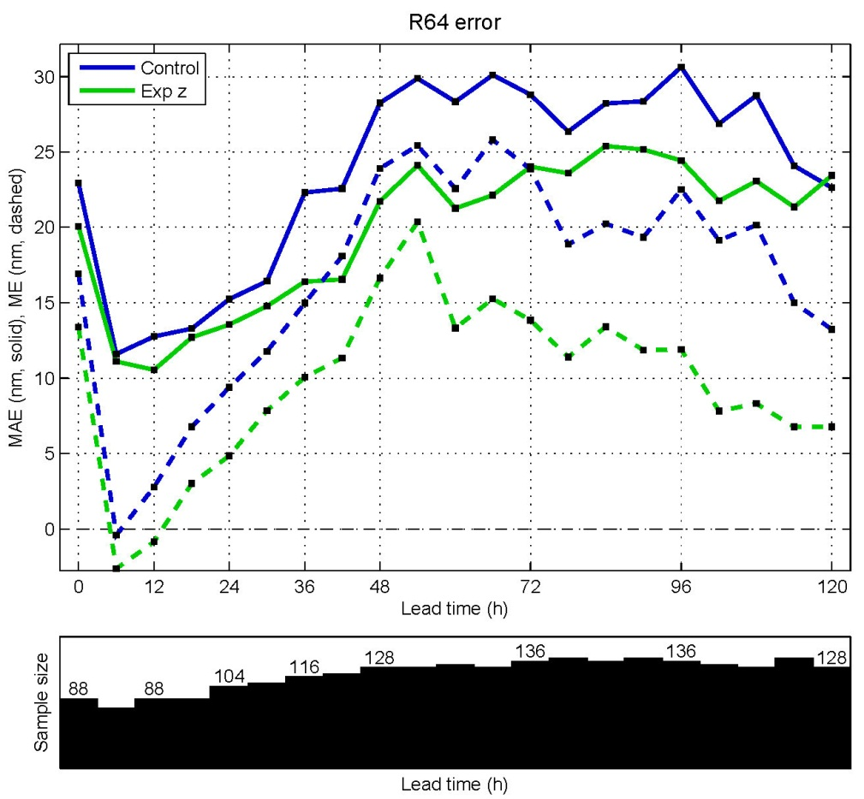
COAMPS-TC Developments
Thompson Microphysics
Intensity Error (kts)
64-kt Radii Error (nm)
Control
Thompson
Microphysics
Control
Thompson
Bias (dash)
Bias (dash)
Thompson (NCAR) microphysics is a double moment scheme.
Thompson implemented into COAMPS-TC improves intensity and structure (e.g., 64 kt wind radii).

Slide 15
COAMPS-TC Development
High Density Observations (HDOB) Assimilation
24-h Track Error: Hurricane Earl
Assimilation of HDOB flight level and SFMR observations.
HDOB flight level data beneficial for Hurricane Earl track skill
Assimilation of SFMR produce reasonable corrections to the background wind speed as part of the 3D-Var (NAVDAS) analysis.
Additional testing underway.
Control
HDOB
SynTC assimilated w/o HDOB
HDOB assimilated w/o SynTC
HDOB and SynTC assimilated
Near center HDOB assimilated w/o SynTC
1000-mb Wind Speed Analysis Inc. (m/s)
12Z Sep 1 2010
Dan Tyndall and Pat Pauley

Slide 16
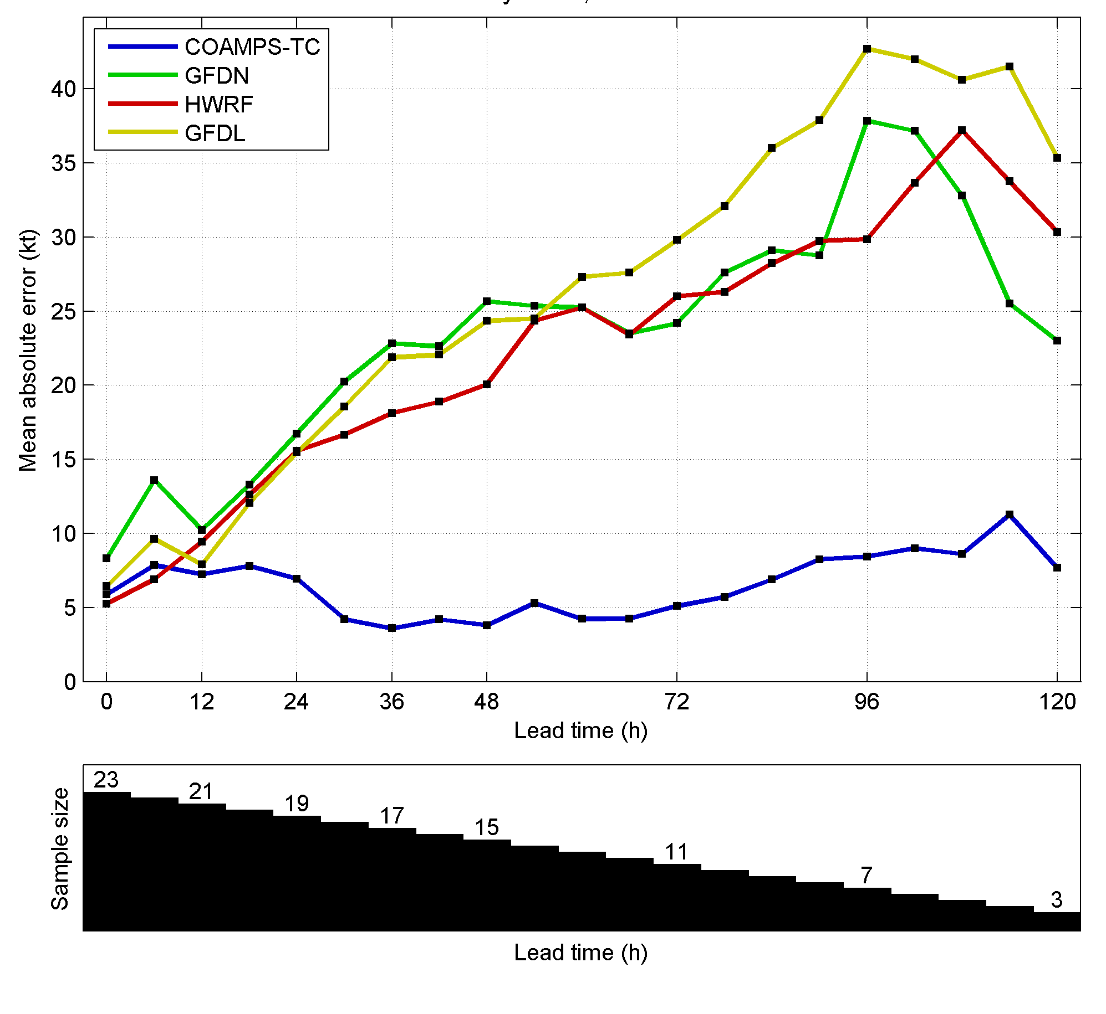
Comparison of Real-Time TC Models
Irene Intensity Errors (kt)
Widespread damage in Eastern U.S., catastrophic flooding in New England
Maximum intensity of 105 kt (Cat. 3)
Landfall in eastern NC at 75 kt (Cat. 1)
Forecasts were for a Cat. 3 landfall
“Intensity remains a big gap in storm science. The National Hurricane Center blew it on predictions of Irene’s wind speed – and it wasn’t the first time”. Miami Herald, 9/2/2011
“CHALLENGES IN PREDICTING THE INTENSITY OF STORMS.” New York Times, 8/27/2011
“HOW IRENE’S FORECAST MISSED THE MARK AND WHY IT COULD HAPPEN AGAIN.” CNN, 8/30/2011
“IRENE FORECASTS ON TRACK; NOT UP TO SPEED ON WIND.” Associated Press, 8/28/2011
“IRENE EXPOSES PROBLEMS FORECASTING HURRICANE INTENSITY” Alaska Dispatch, 8/28/2011
After 00Z 23 September
No interpolation to account for late model fields
COAMPS-TC performed well for Irene as part of the HFIP real-time demonstration, particularly during the critical landfall forecast period.
COAMPS-TC skillfully predicted precipitation event (>15” in NC, and 10-15” in N.E.)

